Slide 1
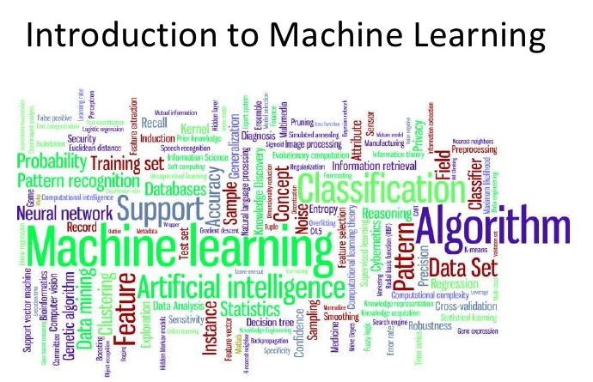

Slide 2
What is machine learning?
True | False
The science of predicting something based on data | A new technology/architecture/framework
A set of tools and techniques to get information from data and act on it | A programming solution for making rule-based decisions like if-else etc. statements
A way of finding patterns in data | A smart system which learns on its own
A mathematical problem where we find the formula to map the inputs and outputs | A system which can learn from any kind of data
Understands only numbers. Other format of data has to be converted into numbers first in the correct way | Not an intelligent system/smarter than humans
Data + Rules
Output
Data + Output
Rules

Slide 3
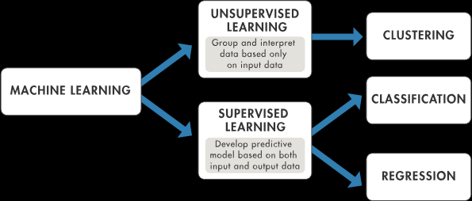

Slide 4
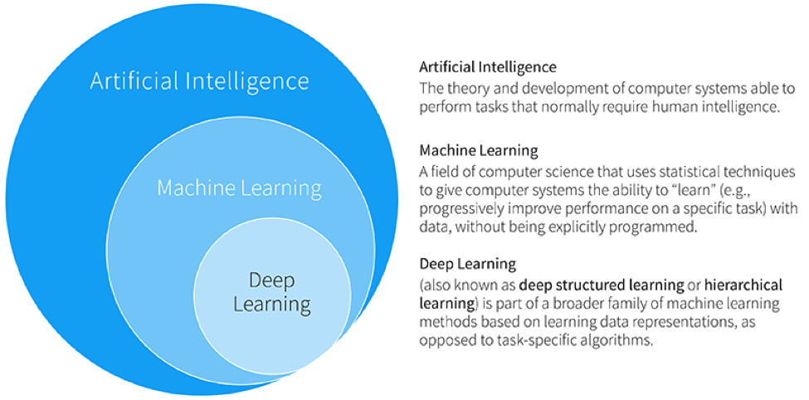

Slide 5



What is a machine learning model?(Classification task)
Infant who knows nothing

Slide 6
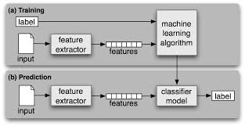
Development
Production

